Slide 1
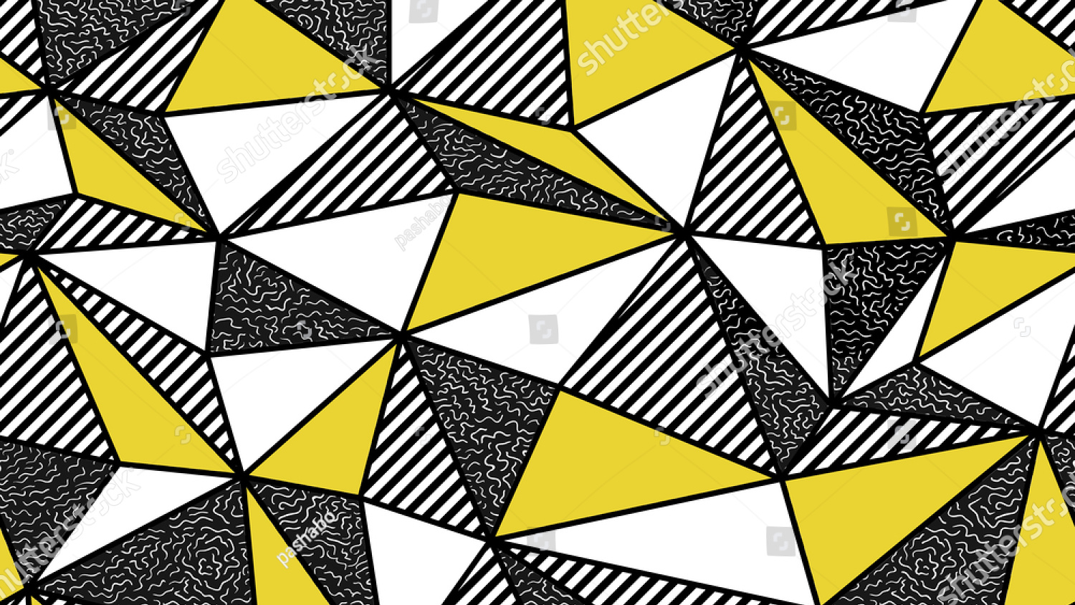

Slide 2


Slide 3

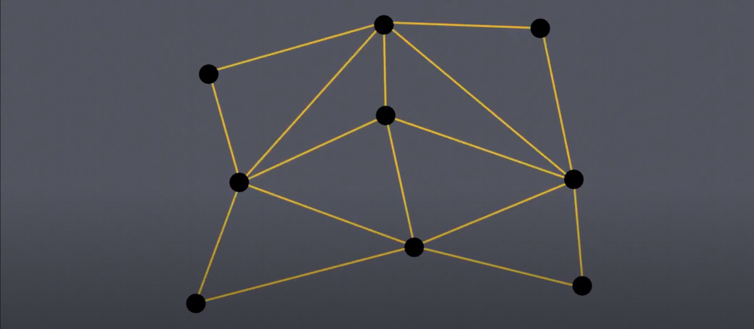
Imagine a set of points on a plane, we need to create a nice triangular mesh out of these points

Slide 4
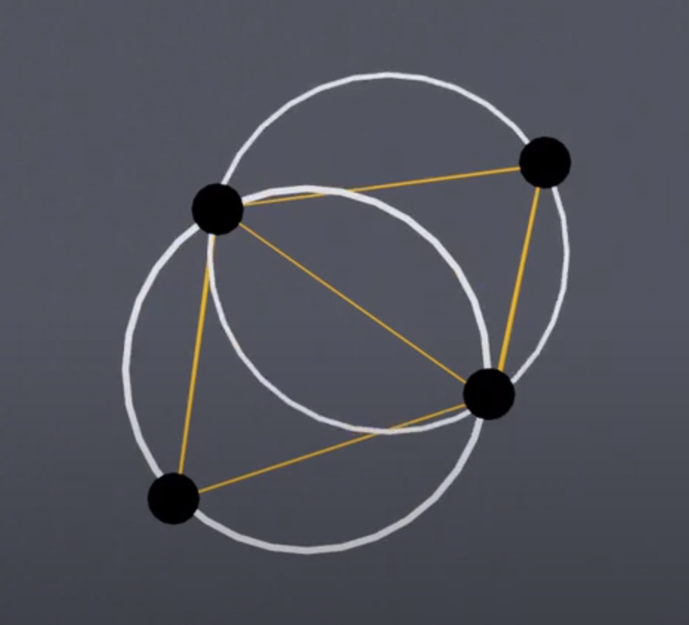
No vertex of a triangle can lie
inside the circumcircle of
another triangle
The circumcircle of a triangle is
a circle passing through all its
verticies

Slide 5
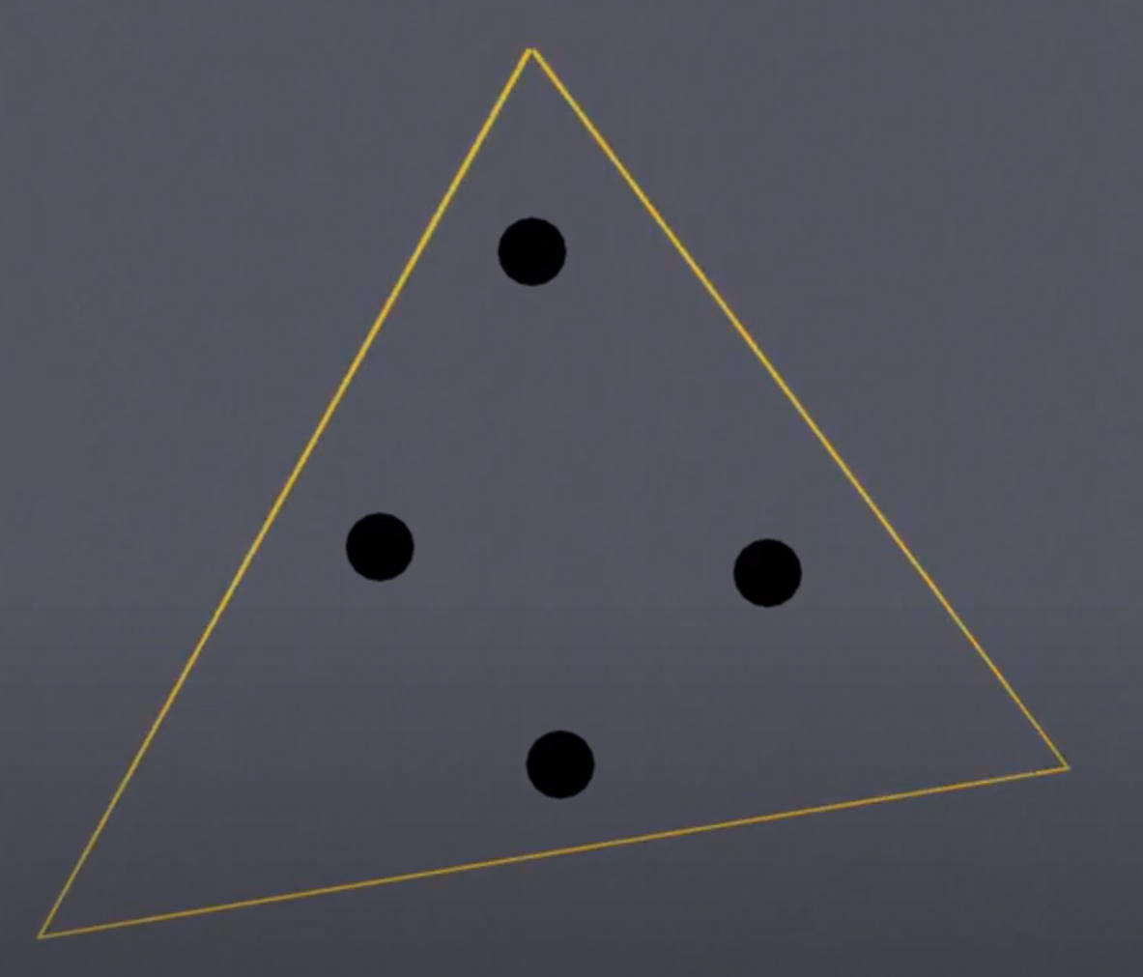
The first step is to find a
triangle that contains all our
points, this is the “super triangle”

Slide 6
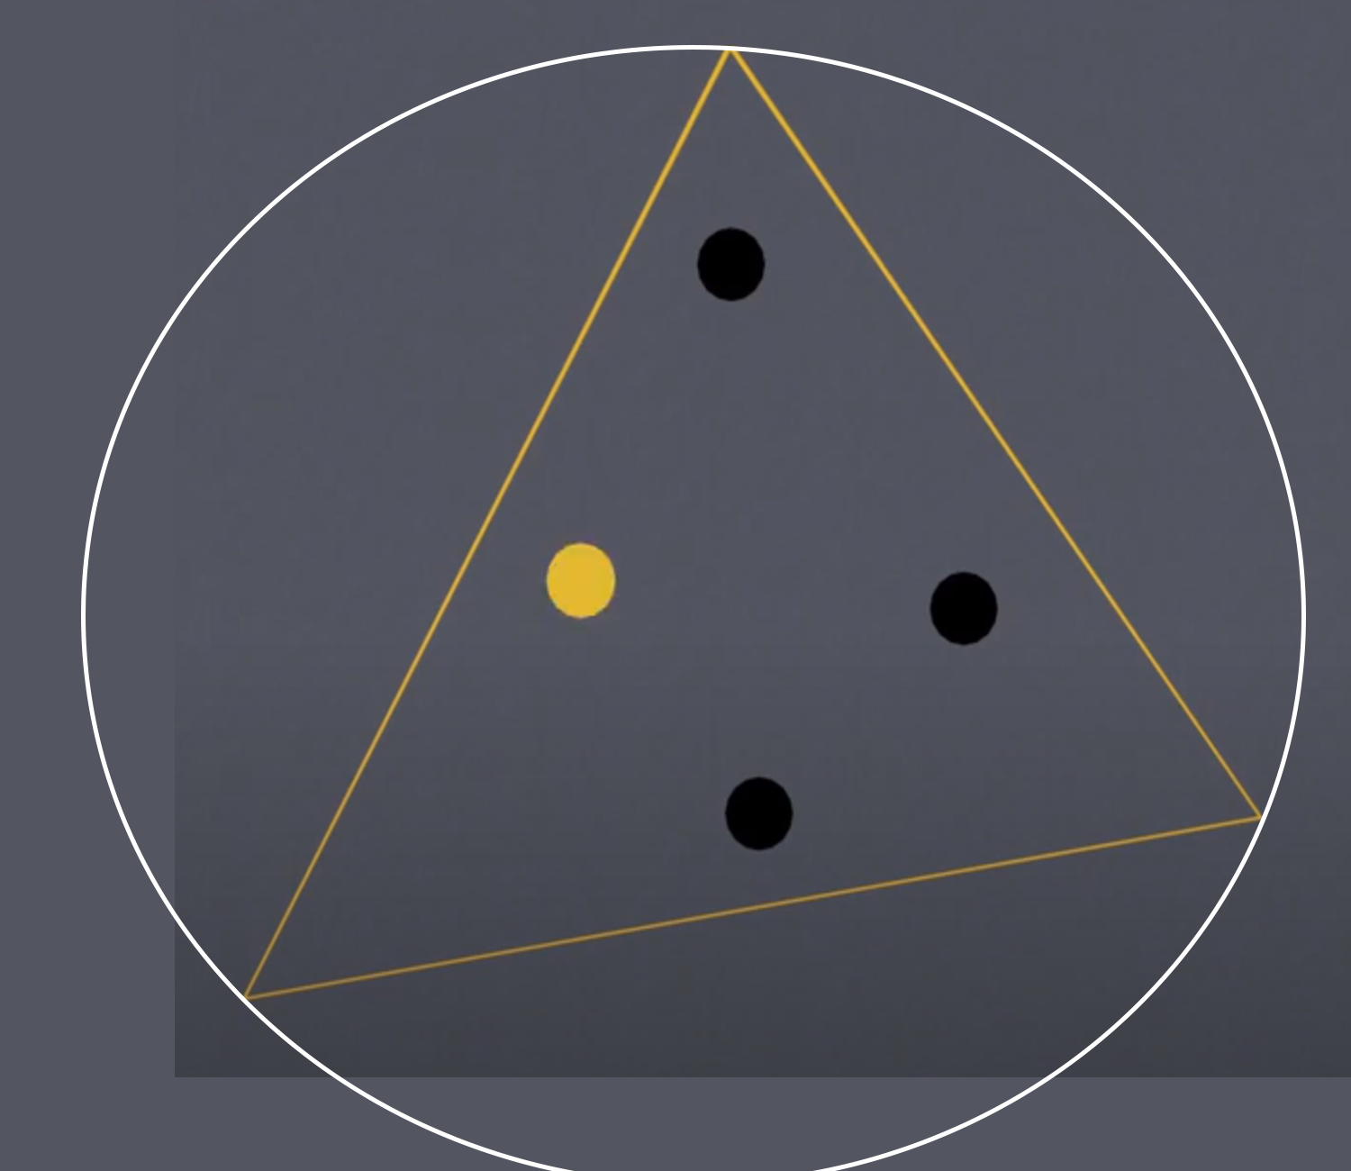
Select a point within the
circumcircle of the super triangle
This will not be a Delaunay
triangle so we will be getting
rid of it at the end

Slide 7
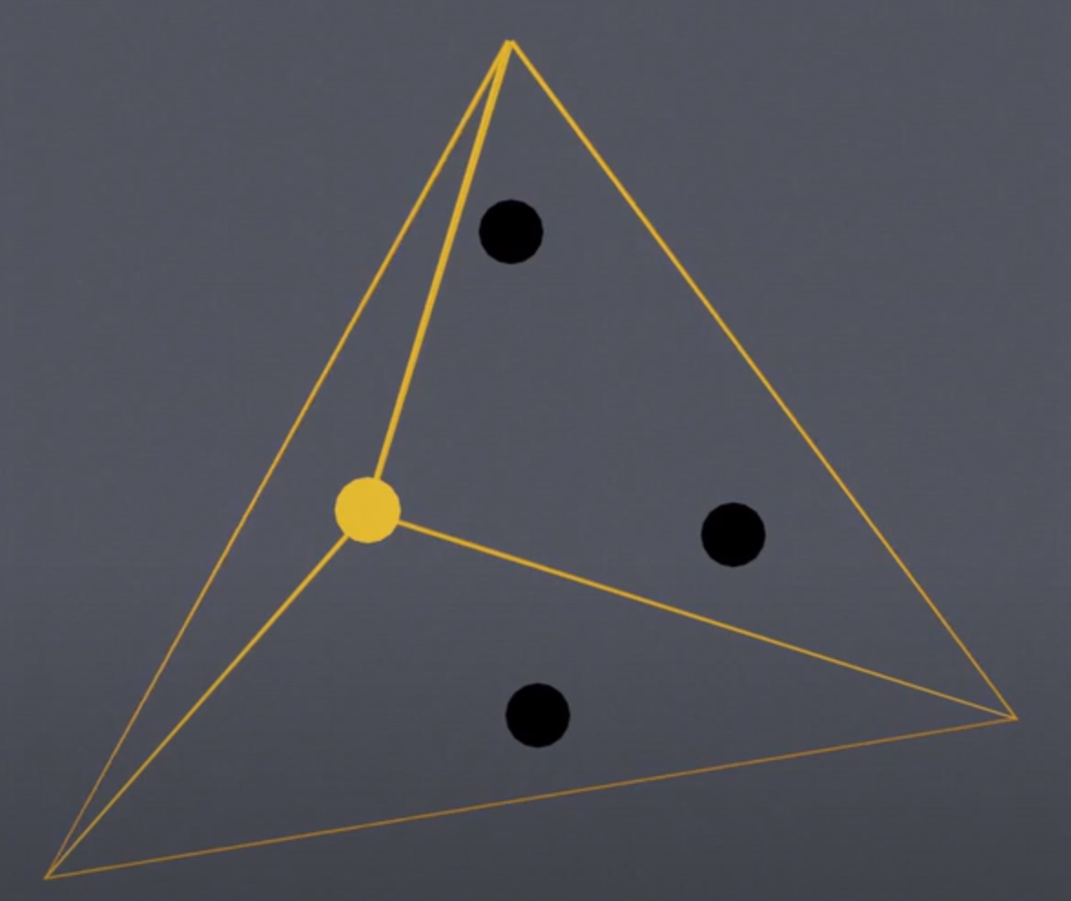
Connect the edges of our triangle
to the point to make a new set
of triangles

Slide 8
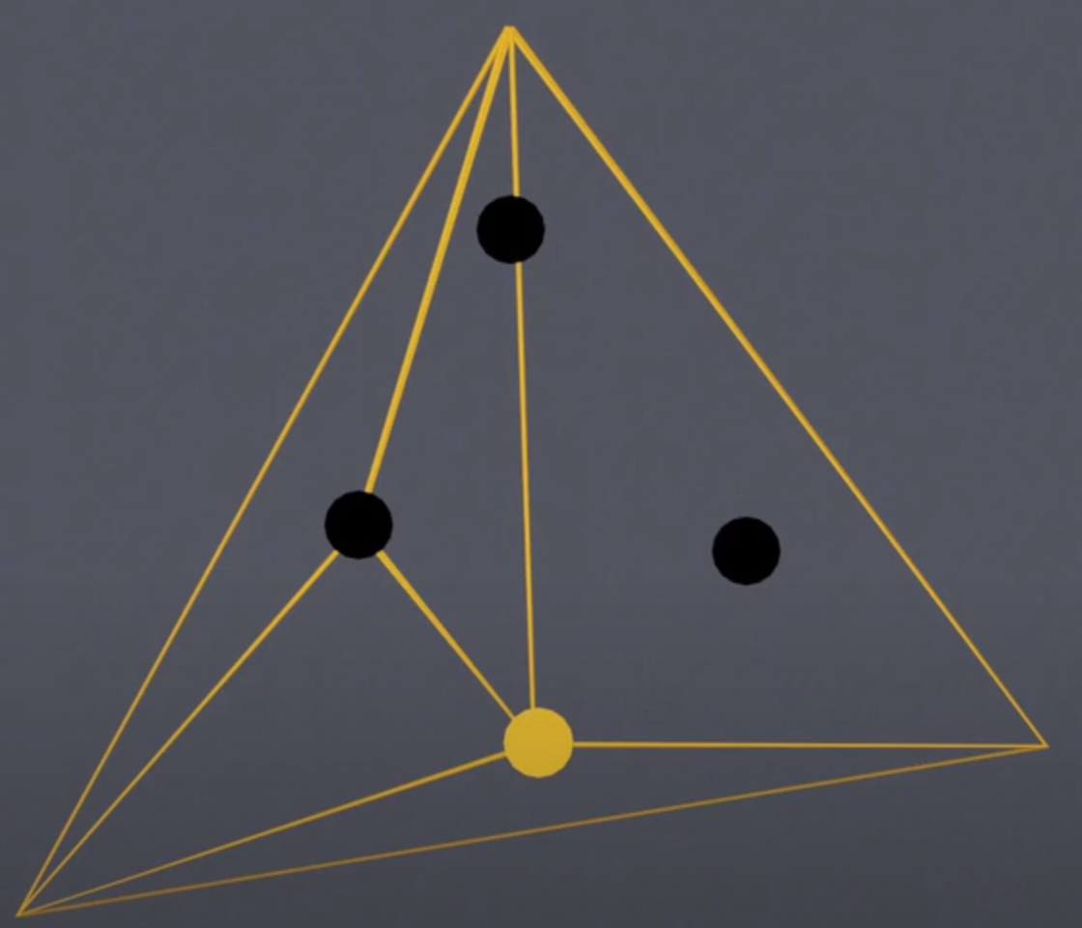
Do this for all remaining points

Slide 9
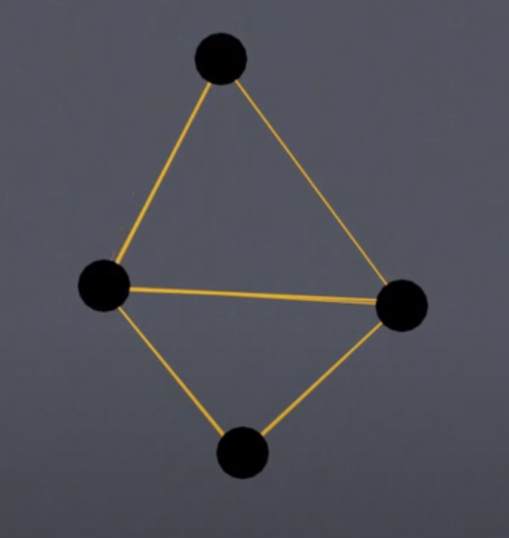
Remove super triangle vertices

Slide 10
